Slide 1
Human Resource Analytics Case Study
SUBMISSION
Logistic Regression Model to Predict if the employee is going to leave the company or not and determine the factors driving it

Slide 2
CASE STUDY OVERVIEW

Slide 3
PROBLEM STATEMENT
A company XYZ has around 9000 employees. However, in every 3-4 months, their employees are leaving and they have to hire new (raw) talent from the market. Training them and guiding them becomes extremely difficult when they have to hire new person in every 3-4 months.
They have contacted a consulting company to understand the factors on which the decision of employees to leave the company depends. Specifically, they want to understand why people are leaving their company on a frequent basis.. The company wants to know:
- Which variables are significant in predicting the decision of leaving the company
- How well those variables describe the probability of the person leaving the company

Slide 4
BUSINESS GOAL
I am required to model the decision of leaving with the available independent variables. It will be used by the management to understand how exactly the decision varies with the independent variables. They can accordingly manipulate the company policies, the business strategy etc. to meet certain employee satisfaction level. Further, the model will be a good way for management to understand the shortcomings in their current system.

Slide 5
DATA UNDERSTANDING

Slide 6
Data Reading and Understanding
The data set contains 14999 entries and 10 columns. The names of those columns are:
Number of projects, work_accident, left, promotion last 5 years, department, salary, time_spend_company, average_monthly_hours, satisfaction_level, last_evaluation
Here, our target variable is LEFT.

Slide 7
ASSUMPTIONS AND DATA HANDLING

Slide 8
Assumptions and Data Handling
Technical: we have assumed that ‘technical’, ‘IT’ and ‘support’ are the same categories. Same with others as well.
Data Cleansing: We have renamed the ‘IT’ and ‘support’ columns to ‘technical’, as per our understanding. We have converted all the data to lower case to avoid any case errors. We renamed ‘average_montly_hours’ to it correct name. The duplicated function searched for any duplicate values in our data and found 3008 entries. Hence, we deleted them. After deletion, we have 9653 entries and 10 columns.
There were no missing values in the data and by performing the above steps, we prepared our data for analysis.
A separate data set corr was created that dealt only with the correlation of our target variable, left. This was done in order to select the best response variables for our study.
Another dataset hr was created that included only the columns that we selected based on our data exploration.

Slide 9
DATA EXPLORATION

Slide 10
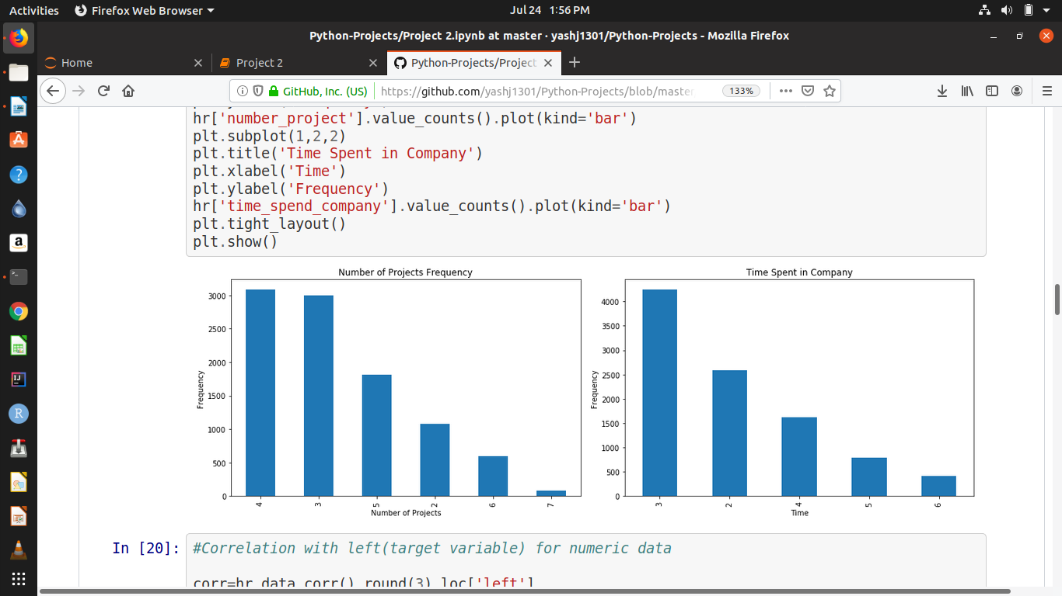
Exploratory Data Analysis
Time Spend Company
It seems that most employees spent just around 3 hours in the company.
Based on our data exploration, we chose the best features that would help us predict the prices of the cars. These are :
Satisfaction Level, Time Spend Company, Last Evaluation, Number of Projects, Work Accident, Promotion last 5 years, Salary, Department
2. Number of Projects
It seems that most employees are able to complete only 4 projects on time.

Slide 11
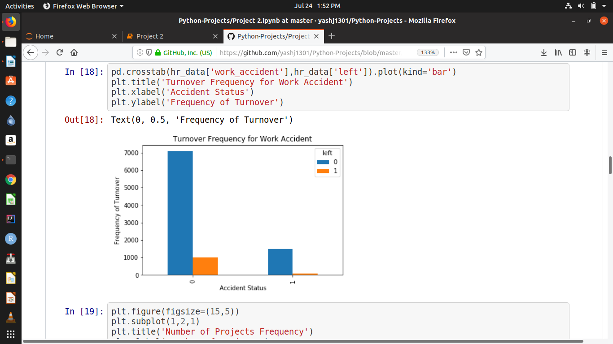
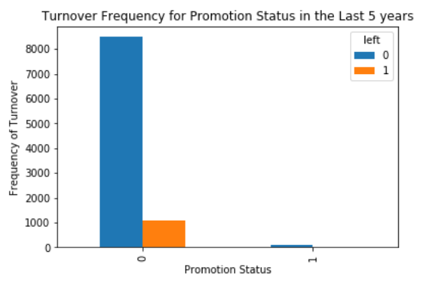
Exploratory Data Analysis
3. Work Accident
It seems that people who don’t have any work accidents are leaving the company more.
Based on our data exploration, we chose the best features that would help us predict the prices of the cars. These are :
Satisfaction Level, Time Spend Company, Last Evaluation, Number of Projects, Work Accident, Promotion last 5 years, Salary, Department
4. Promotion Status in the last 5 years
It is clearly visible that people are often not getting promotions and hence they are leaving the company.

Slide 12
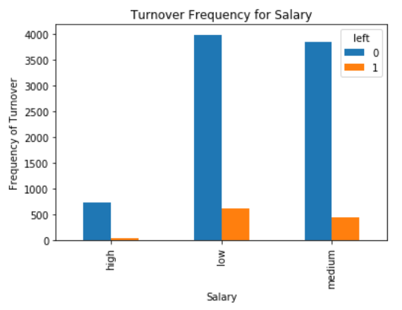
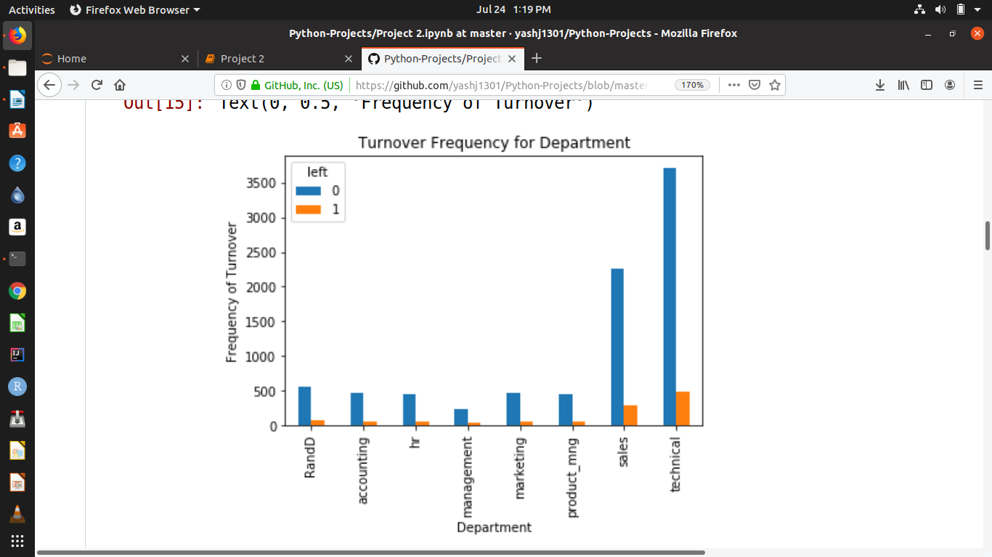
Exploratory Data Analysis
5. Salary
It seems that people with low salary range are leaving the company more frequently.
Based on our data exploration, we chose the best features that would help us predict the prices of the cars. These are :
Satisfaction Level, Time Spend Company, Last Evaluation, Number of Projects, Work Accident, Promotion last 5 years, Salary, Department
6. Department
It seems that most people leaving the company are from technical department.

Slide 13
TECHNIQUE COMPARISON
Simple Logistic Regression vs Random Forest Classifier

Slide 14
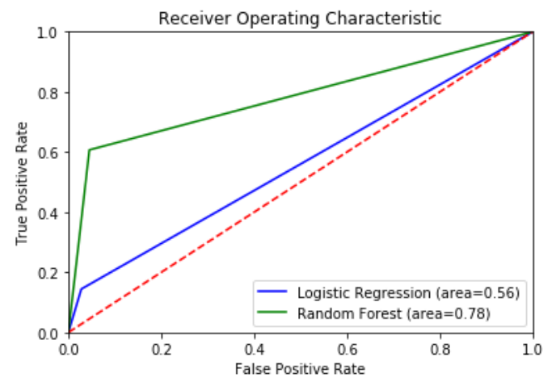
Technique Comparison
Simple Logistic Regression | Random Forest Classifier
In Simple Logistic Regression, Our Accuracy Score was 88.607%. The Receiver Operative Characteristic (ROC) Curve was covering area=0.56. | Using Random Forest, Our Accuracy Score was 91.25%. The Receiver Operating Characteristic (ROC) Curve was covering area=0.78.
ROC Curve:

Slide 15
SUGGESTIONS AND INSIGHTS

Slide 16

One of the most important thing for an employee is his salary. Most employees leaving the company have low or medium salary.
Promotion is something that motivates an employee to give his 100% for the company. However, the people leaving the company did not get promotion for half a decade.
The company is inflicting workload too much on the employees. Most employees are able to complete only 4 projects on time.
Training could be done more efficiently. Most people leaving are from technical background.
Satisfaction level of employees is very important for a company. Hence, they should work on keeping the satisfaction level of the employees high.
Suggestions and Insights

Slide 17
An employee is an asset to the company. They define the future and present of the company.
NOTE:

Slide 18

Thanks! You can access the project in the following GITHUB Repository:
https://github.com/yashj1301/Python-Projects/tree/master/HR%20Analytics
Contact details:
Yash Jain
9582617525
Greater Noida, UP-201306
yash.jain106@gmail.com
https://www.linkedin.com/in/yash-j-5537a0146/

